Slide 1
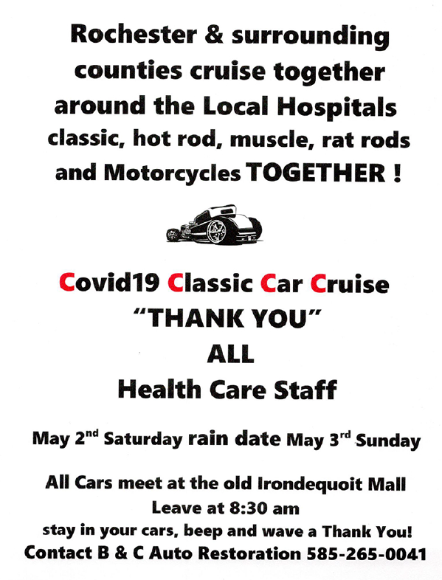

Slide 2
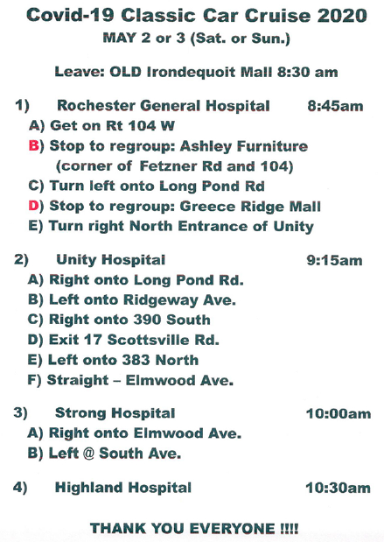
Step 1B was not able to
Happen. Too many
Participants. Go To Mall.

Slide 3
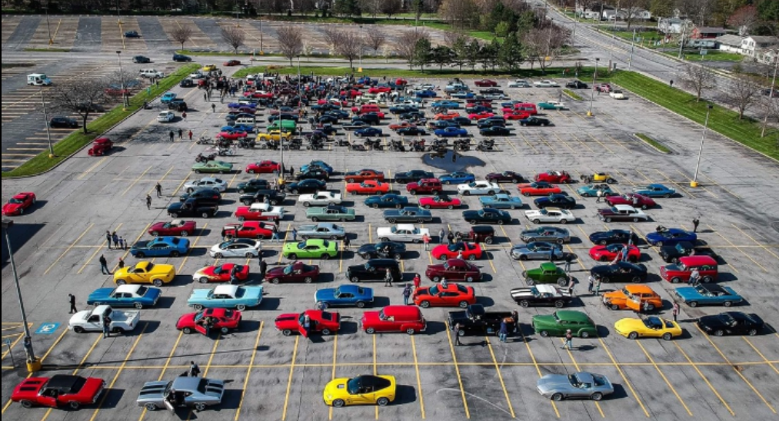
The regroup stop at
Greece Ridge Center Mall
at the old Sears Parking
area. Some cars/trucks
were cropped from this.
400+ Vehicles took part.

Slide 4
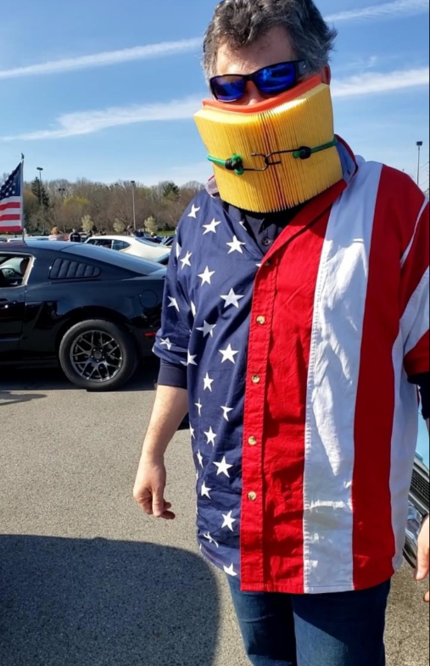
Me during the regroup
practicing social distancing
We were not allowed to
get out at the hospitals

Slide 5
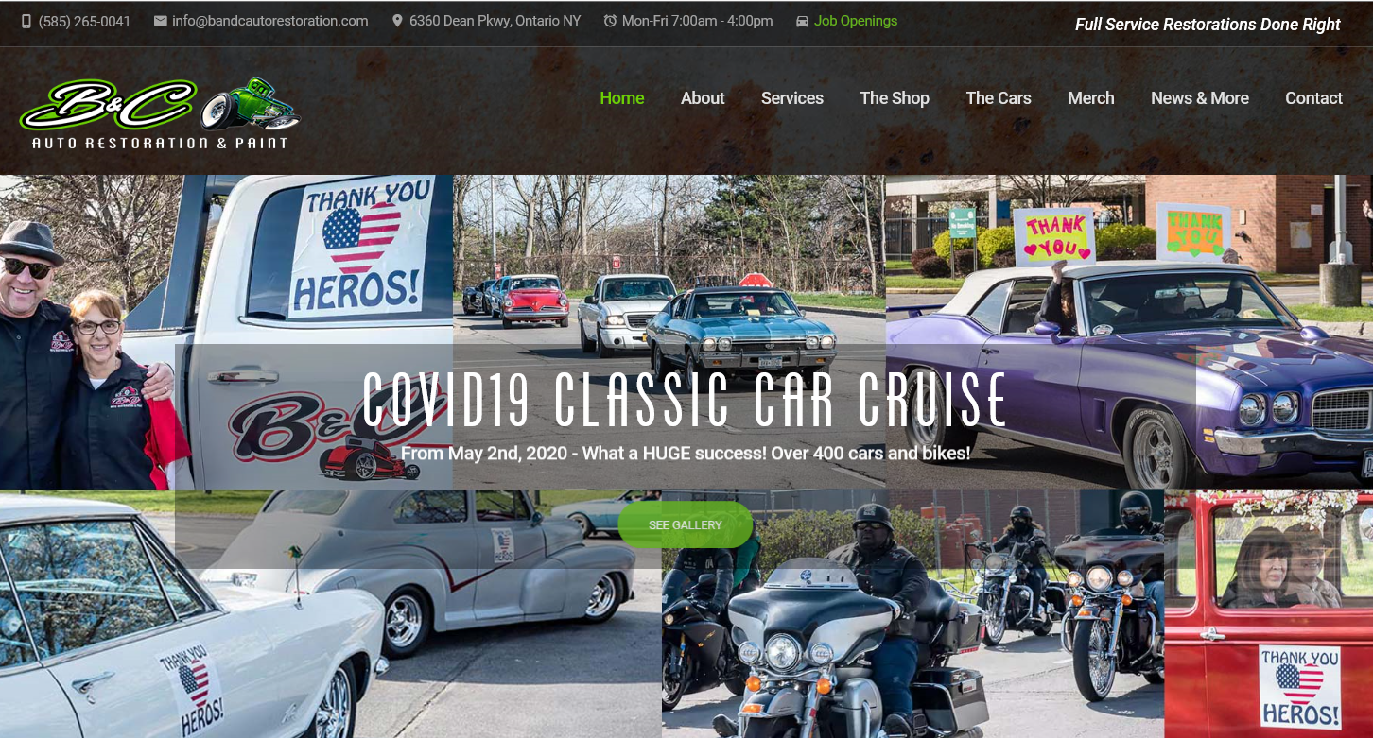
www.bitchencustoms.com

Slide 6
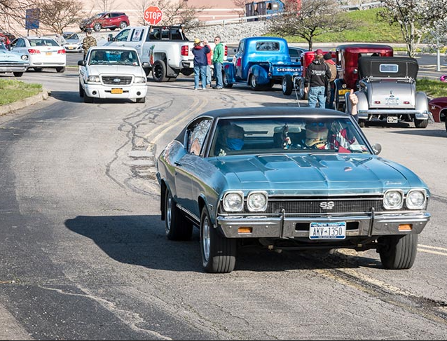
NOTE : Face-Filter in use
upon arriving at old
Irondequoit mall

Slide 7
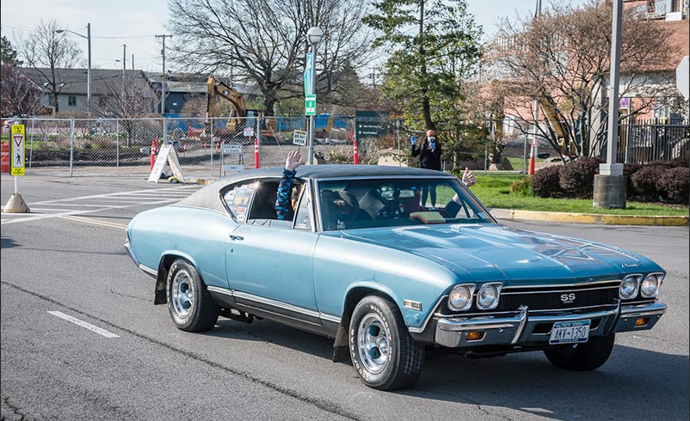
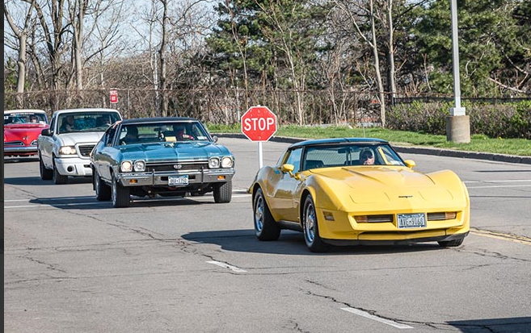

Slide 8
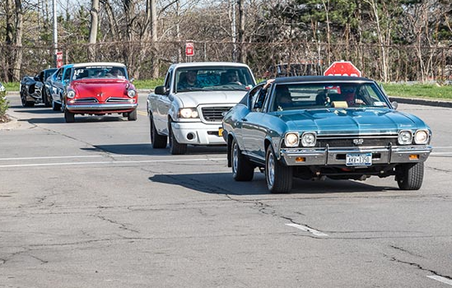
Todd and Caswell
Contingent
(NOTE: the Red, White and Blue)

